Slide 1
Lab 8 “Purely a Matter of Taste” Inference for a Population Proportion
STAT 201: Elementary Statistics

Slide 2
Taste Test
Are name brand products really worth the extra money?
We will compare a name brand food and drink product to the Publix brand alternative of that food or drink.
name brand vs Publix (bargain brand)
½ of you will set up the test for a drink product.
½ of you will set up the test for a food product.
You are not required to taste anything.
If you are allergic to a product do not consume it.

Slide 3
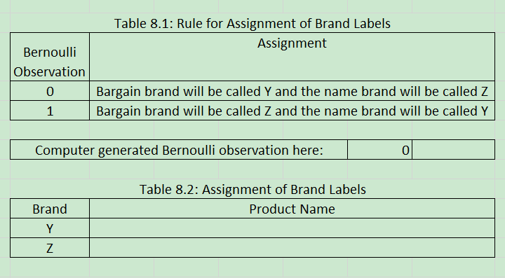
Step 1: Randomly Assign Product Label

Slide 4
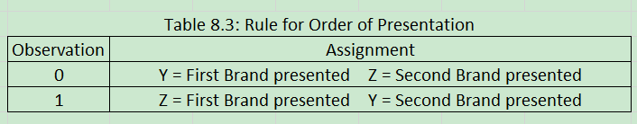
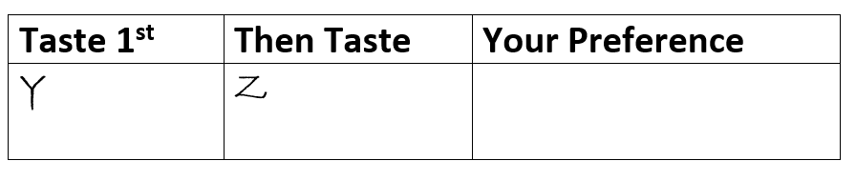
Step 2: Randomly Decide the Tasting Order for each Student that will Taste the Product
Different instructors might have different ways
Use computer to generate random order
Be given a piece of paper with order already on it
Be ask to draw a bead out of the bucket on the table to randomize the order

Slide 5
Setting up the Product for a Single Blind Taste Test
At the table that has the supplies: cups/coffee filters, markers, gloves, and product:
Put gloves on first!
Label 48 cups/coffee filters Y and 48 cups/coffee filters Z.
Make sure all Y cups/coffee filters are grouped together on one side of the table and all Z cups/coffee filters are grouped together on the other side of the table.

Slide 6
Setting up the Product for a Single Blind Taste Test
Create individual servings:
Pour enough of the drink cup for each student to get a taste of each drink (you have 4 cans of each soda or a gallon of apple juice total so just evenly distribute in the cups). Place one cookie into each coffee filter.
Remember to put the correct product into cups/coffee filter labeled Y and the correct product into cups/coffee filters labeled Z (don’t mix them up). The assignment was determine by the coin flip.

Slide 7
Setting up the Product for a Single Blind Taste Test
Clean up the area:
Remove all product packaging from the table – the only thing on the table should be the drinks/cookies in cups/coffee filters labeled Y and Z. (remember one section for Y and one section for Z).
Make sure you don’t have something visible that states whether the bargain brand was labeled Y or Z.

Slide 8
Directions to Collect the Data After the Set-up has Been Completed:
Select 6 members from the 12 that are working with the product (drink or cookie) to go to the other two lab rooms (LeConte 124 – downstairs near the Greene St side of the building, LeConte 205 – towards middle of hall, and LeConte 200A – at the end of the hall opposite of Greene St. on the left.) to taste the drink and cookie product they have setup in the same fashion as you just did.
The other 6 members will stay in their lab room, where you set up the product, to administer the taste test to students coming from the other two lab rooms.
******** ½ of you go taste in the other rooms and ½ of you stay in the room to help those coming to taste your product. Once your lab group members return you switch (those that stayed go and taste from the other rooms and those that went administer the taste test) ************************************************************

Slide 9
Giving instructions to students that come to taste your product:
Have 2 of your group members at a table that contains the sheets that tell the students which item to taste first and which item to taste second (they need to draw a paper and take it with them).
Have 2 of your group members at the table where the products are administered to make sure students are tasting in the order as it appears on the slip of paper they just picked up.
Have 2 of your group members at the remaining table to collect the sheets of papers. Students are to write down (have a pen or pencil available for those that didn’t bring one) which product they preferred (Y or Z). The student should not state their preference but write it down.
********* Each student that enters the room from one of the other labs should taste both the soda and the cookie in the room. DO NOT TASTE THE COOKIE IN THE ROOM WHERE YOU HAVE LAB *******

Slide 10
Answer all Discussion Questions
1. Did we use a random sample?
Note that most methods used later in the discussion questions to make inference require a random sample. If this was not a random sample then state that but still use the methods for inference.
2. Two ways attempted to control for factors other than taste that could affect preference.
3. Proportion preferring bargain (last value in table 8.5 on page 62).
7. Read the Reality Check

Slide 11
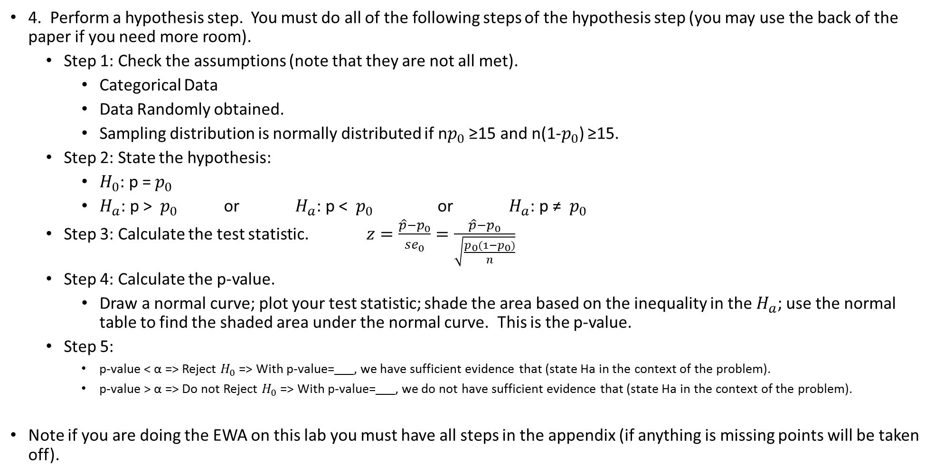
Answer Discussion Questions (also attached in my website)
4. Perform a hypothesis step. You must do all of the following steps of the hypothesis step (you may use the back of the paper if you need more room).
Step 1: Check the assumptions (note that they are not all met).
Categorical Data
Data Randomly obtained.
Sampling distribution is normally distributed if n$p_{0}$ ≥15 and n(1-$p_{0}$) ≥15.
Step 2: State the hypothesis:
$H_{0}$: p = $p_{0}$
$H_{a}$: p > $p_{0}$ or $H_{a}$: p < $p_{0}$ or $H_{a}$: p ≠ $p_{0}$
Step 3: Calculate the test statistic. $z=\frac{\hat{p}−p_{0}}{{se}_{0}}=\frac{\hat{p}−p_{0}}{\sqrt{\frac{p_{0}(1−p_{0})}{n}}}$
Step 4: Calculate the p-value.
Draw a normal curve; plot your test statistic; shade the area based on the inequality in the $H_{a}$; use the normal table to find the shaded area under the normal curve. This is the p-value.
Step 5:
p-value < α => Reject $H_{0}$ => With p-value= , we have sufficient evidence that (state Ha in the context of the problem).
p-value > α => Do not Reject $H_{0}$ => With p-value= , we do not have sufficient evidence that (state Ha in the context of the problem).
Note if you are doing the EWA on this lab you must have all steps in the appendix (if anything is missing points will be taken off).

Slide 12
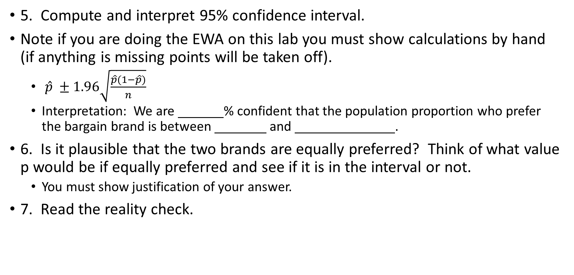
Answer Discussion Questions(also attached in my website)
5. Compute and interpret 95% confidence interval.
Note if you are doing the EWA on this lab you must show calculations by hand (if anything is missing points will be taken off).
$\hat{p} ±1.96\sqrt{\frac{\hat{p}(1−\hat{p})}{n}}$
Interpretation: We are % confident that the population proportion who prefer the bargain brand is between and .
6. Is it plausible that the two brands are equally preferred? Think of what value p would be if equally preferred and see if it is in the interval or not.
You must show justification of your answer.
7. Read the reality check.

Slide 13
Before you leave:
Make sure you have all tables 8.4 and 8.5 filled out (this is the data you need to write your EWA).
Make sure you have answered all questions in the lab book. Make sure you have done all parts of the hypothesis test and confidence interval calculations as these must be in the appendix in the EWA and it must be done by hand.
Show your lab instructor your completed questions so you can get points for the lab in the gradebook.
Take all your work with you (including the questions you generally turn in) so you can write your paper.

